Slide 1
Introduction to Statistical Learning
Chapter 1 and 2

Slide 2
Statistical learning
supervised
unsupervised

Slide 3
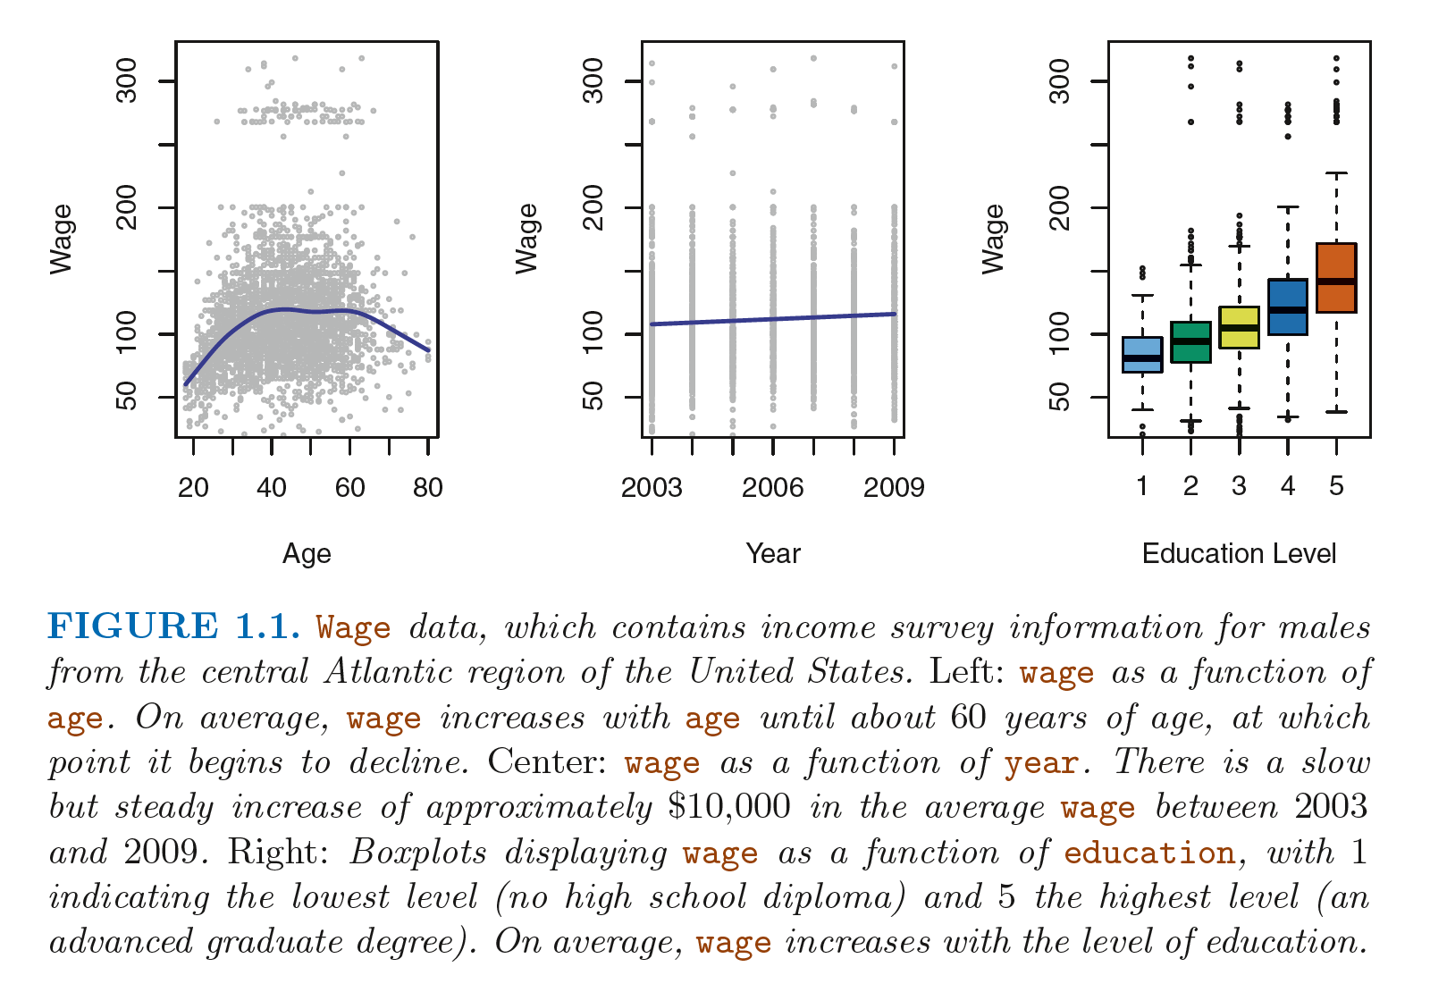
Wage Data – numeric/quantitative value prediction

Slide 4
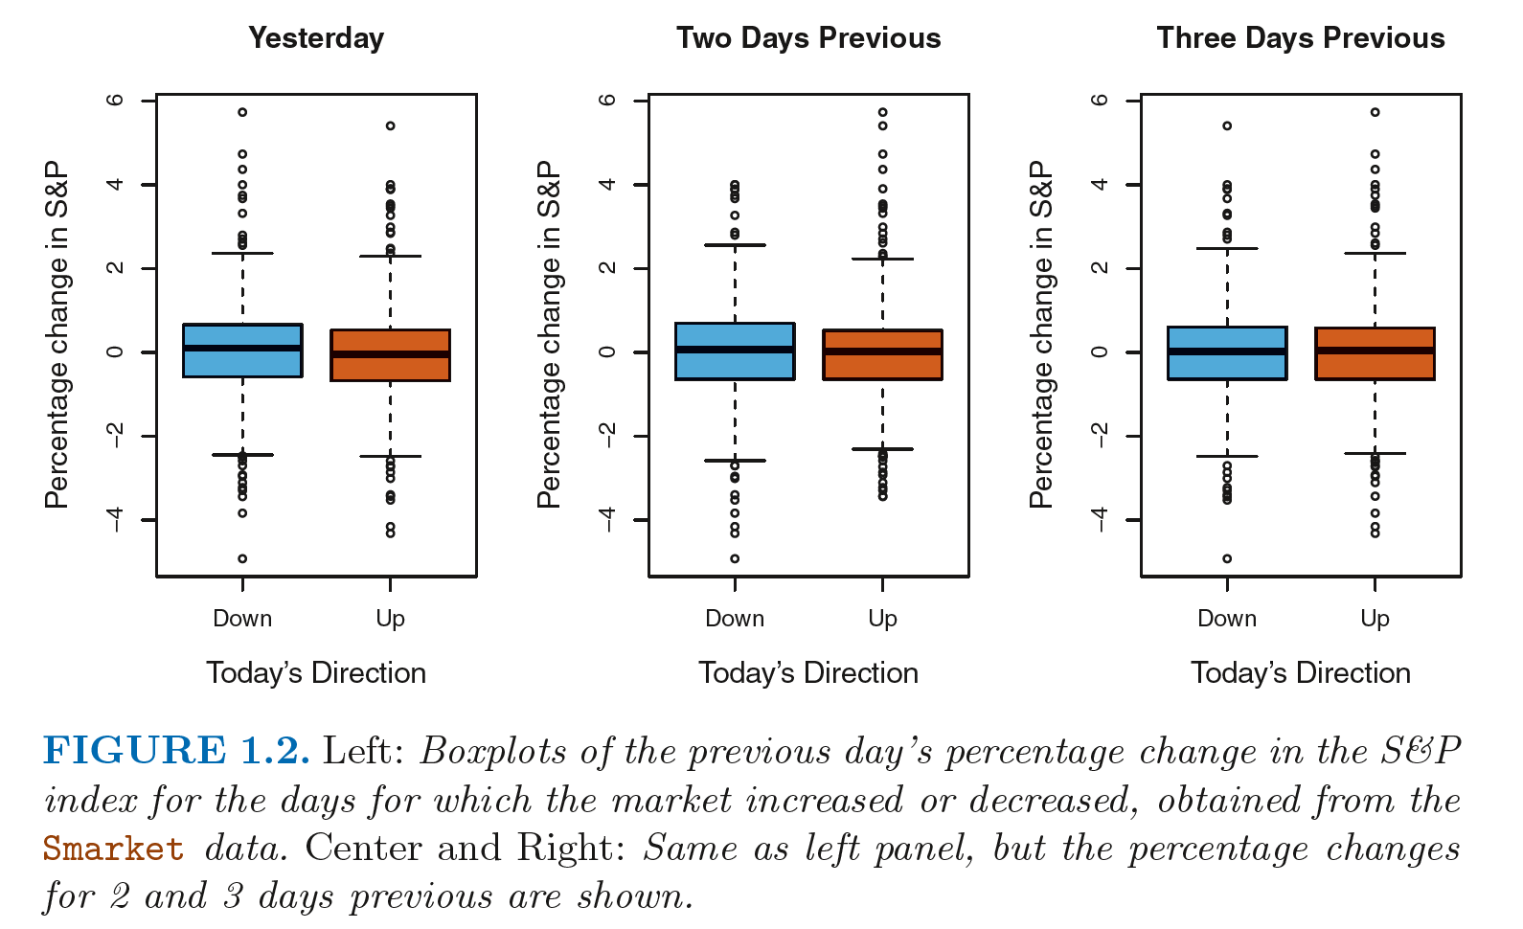
Stock Market Data – Categorical/Qualitative Prediction

Slide 5
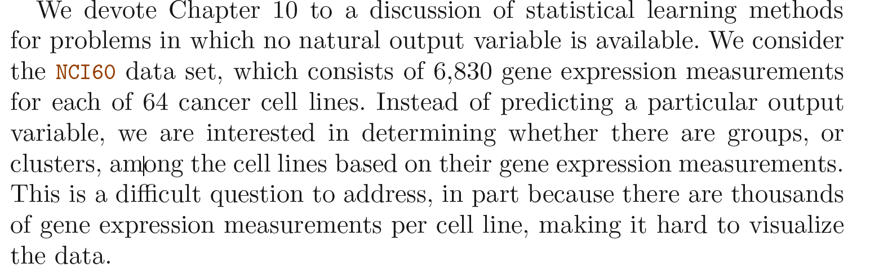
Gene Expression Data – unsupervised
Clustering problem

Slide 6
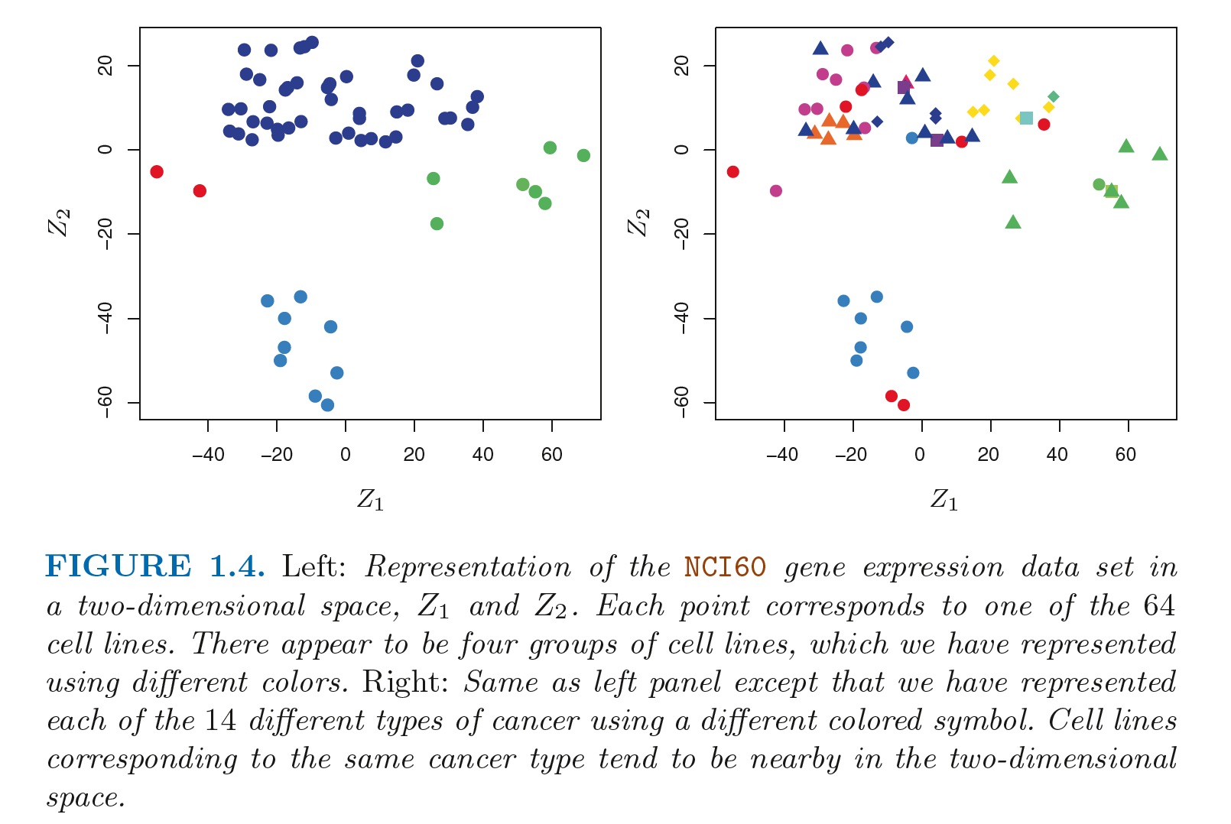

Slide 7
History
Beginning of 19th century
Method of least squares -> linear regression
1963 – Linear discriminant analysis for classification problems
1940s - logistic regression for classification problems
1970s - generalized linear models ( entire class of statistical learning methods that include both linear and logistic regression as special cases)
1980s, - computers - non-linear methods were no longer computationally prohibitive
Classification, regression trees, cross-validation
1986 – Generalized additive models - non-linear extensions to generalized linear models

Slide 8
ISL premises
Many statistical learning methods are relevant and useful in a wide range of academic and non-academic disciplines, beyond just the statistical sciences.
Statistical learning should not be viewed as a series of black boxes.
While it is important to know what job is performed by each cog, it is not necessary to have the skills to construct the machine inside the box!
We presume that the reader is interested in applying statistical learning methods to real-world problems

Slide 9
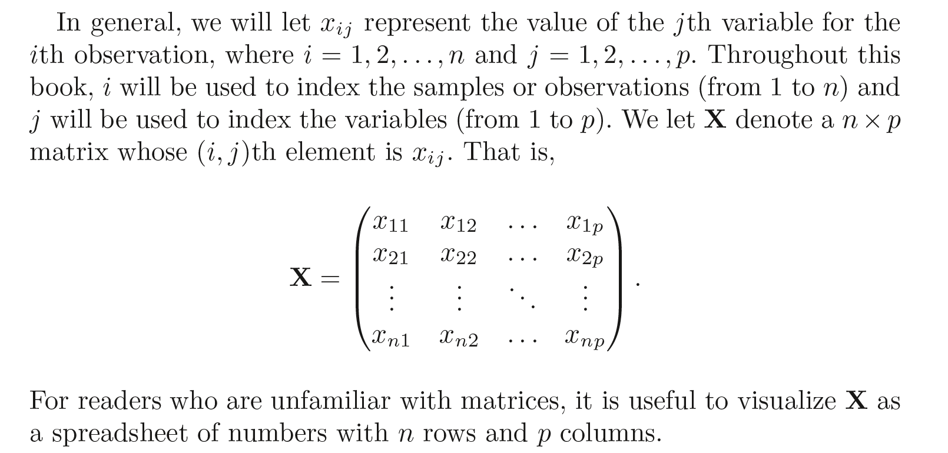
Notation and Simple Matrix Algebra

Slide 10
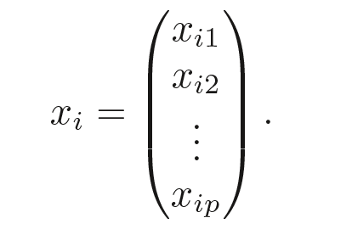
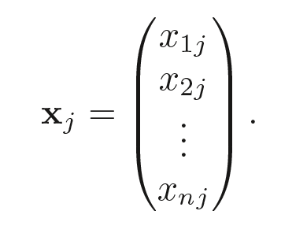

Slide 11
Matrices will be denoted using bold capitals , such as A
Random variables will be denoted using capital normal font such a A regardless of their dimension
a ∈ R (Scalar)
a ∈ R^{k} (vector of length k)
A ∈ R^{rxs} (r x s matrix)

Slide 12
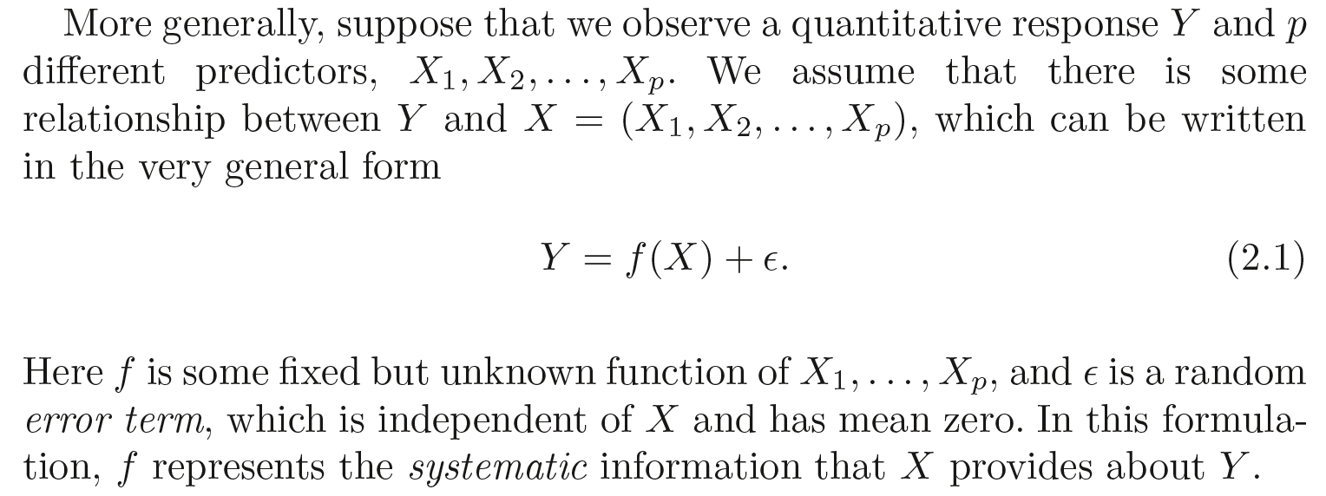
What Is Statistical Learning?
Inputs - predictors, independent variables, features, variables.
output - response, dependent variable
statistical learning refers to a set of approaches for estimating f

Slide 13
Why estimate f?
prediction
inference

Slide 14
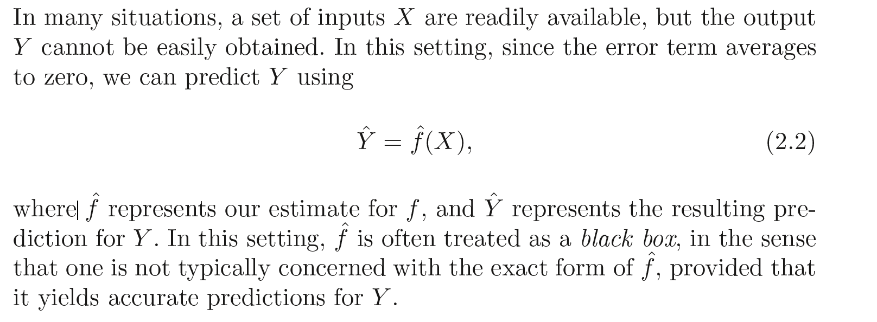
prediction

Slide 15
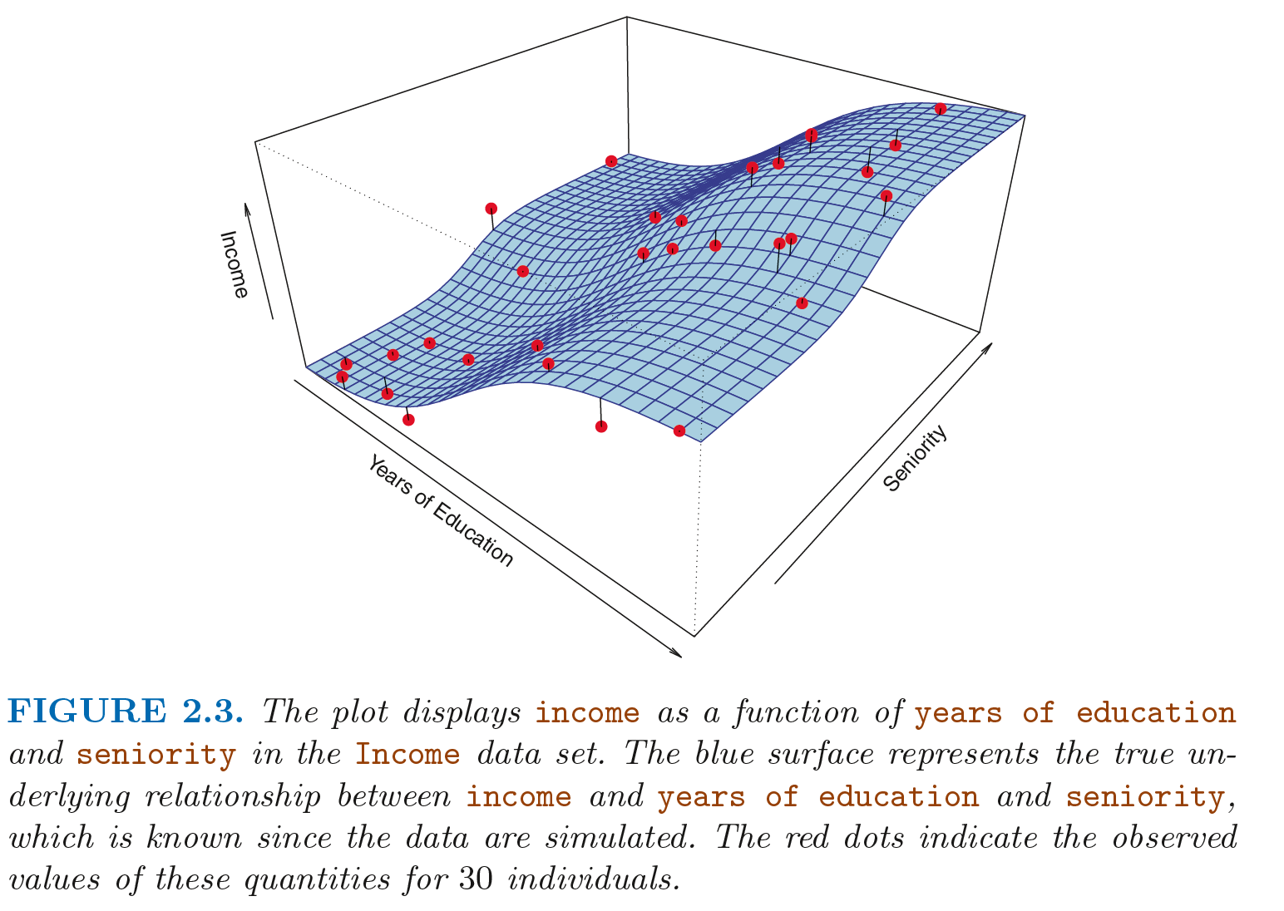
True F based on Simulated data – Wage data

Slide 16
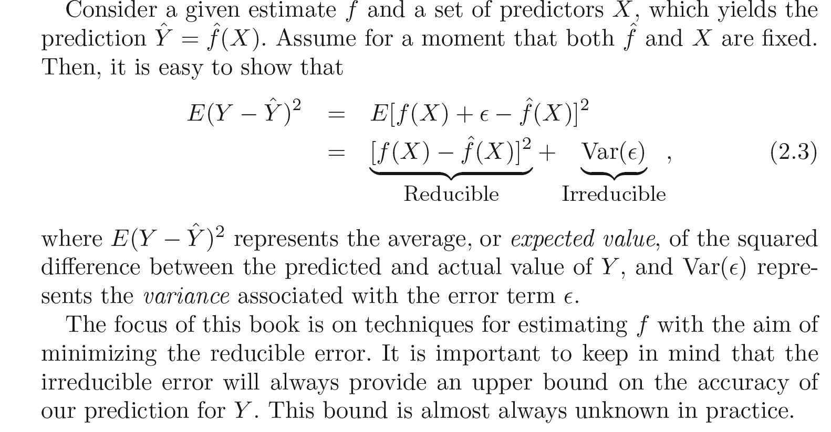

Slide 17
inference
Understand the relationship between X and Y
Which predictors are associated with the response?
What is the relationship between the response and each predictor?
Can the relationship between Y and each predictor be adequately summarized using a linear equation, or is the relationship more complicated?

Slide 18
Advertising data – inference example
Which media contribute to sales?
Which media generate the biggest boost in sales?
How much increase in sales is associated with a given increase in TV advertising?

Slide 19
How Do We Estimate f?
Parametric
Non-parametric

Slide 20
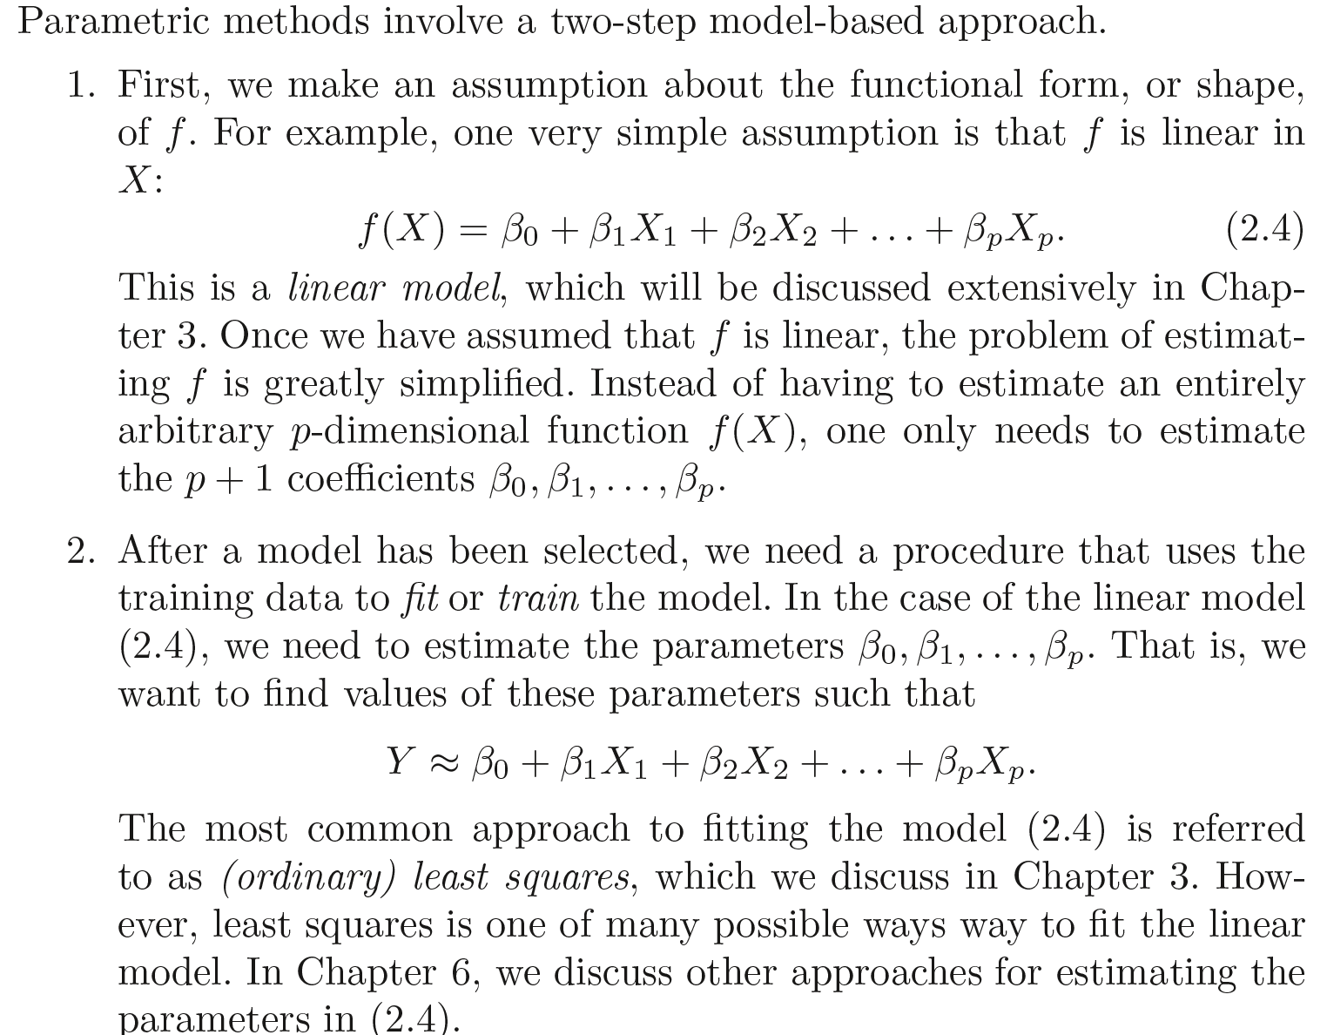
Parametric Methods

Slide 21
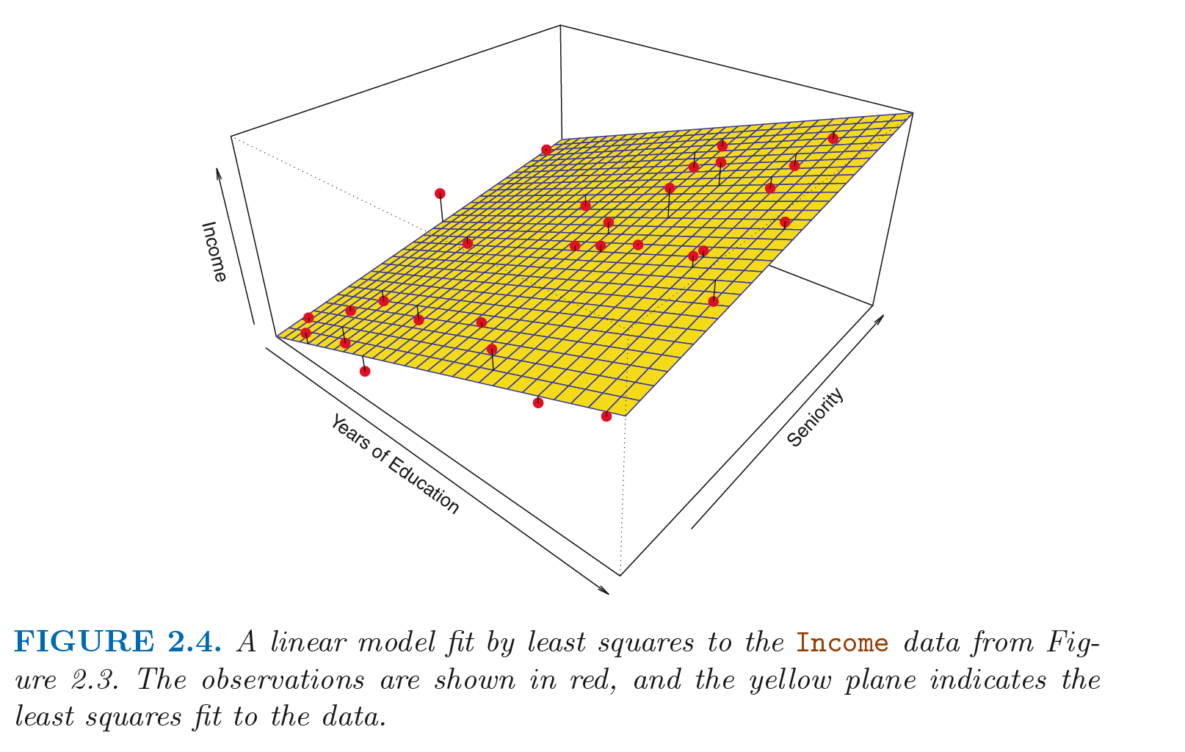

Slide 22
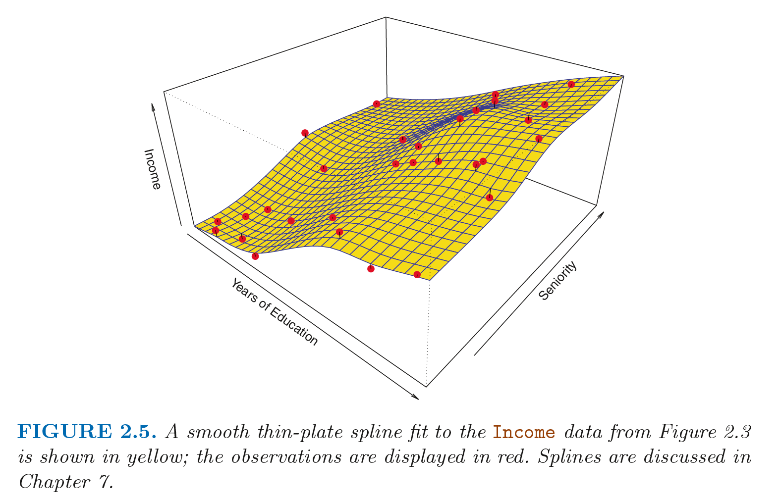

Slide 23
Non-parametric Methods
methods do not make explicit assumptions about the functional form of f. Instead they seek an estimate of f that gets as close to the data points
Advantages over parametric approaches
Accurately fits a wider range of possible shapes for f .
But non-parametric approaches do suffer from a major disadvantage: since they do not reduce the problem of estimating f to a small number of parameters, a very large number of observations

Slide 24
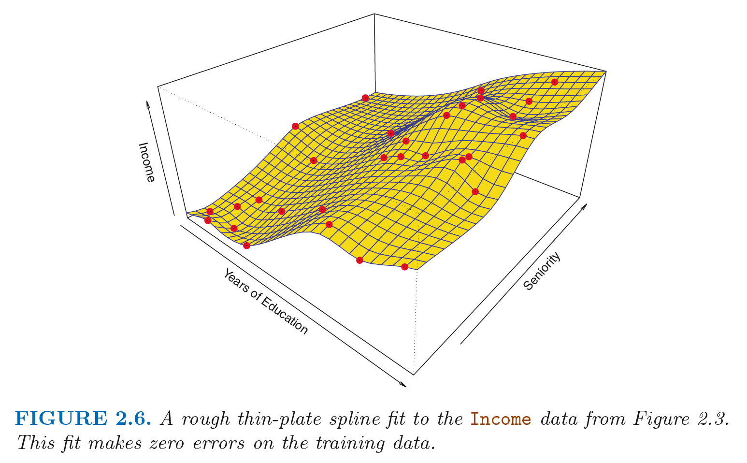

Slide 25
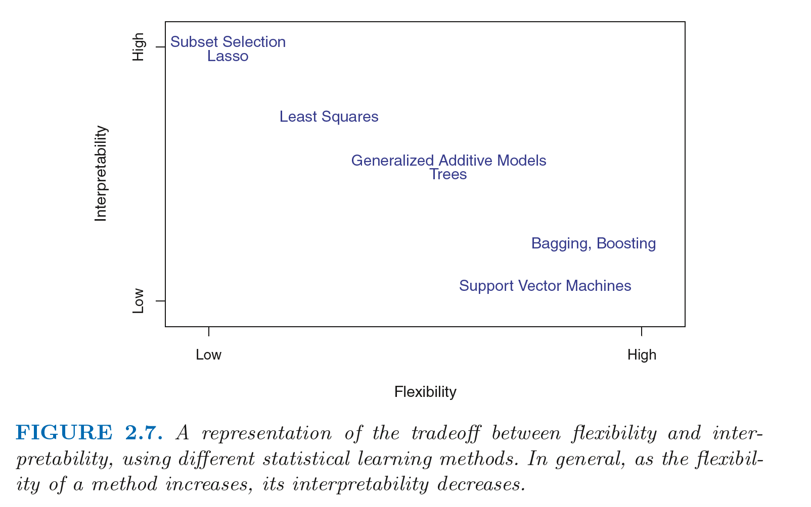
The Trade-Off Between Prediction Accuracy and Model Interpretability

Slide 26
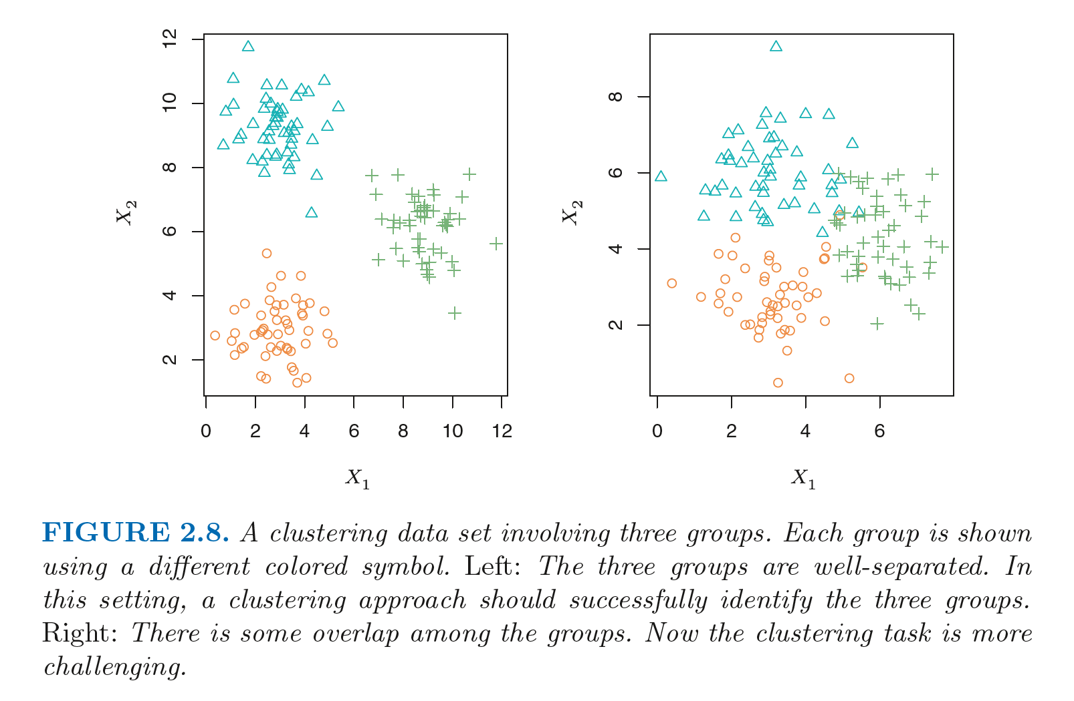
Supervised Versus Unsupervised Learning
Supervised
linear regression, logistic regression, GAM, boosting, support vector machine
unsupervised
Clustering

Slide 27
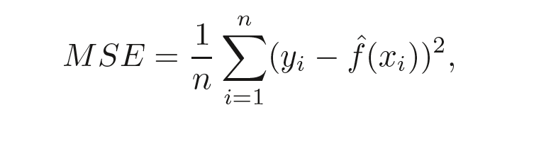
Assessing Model Accuracy
Measuring the Quality of Fit with mean squared error (MSE)
Computed using training data

Slide 28
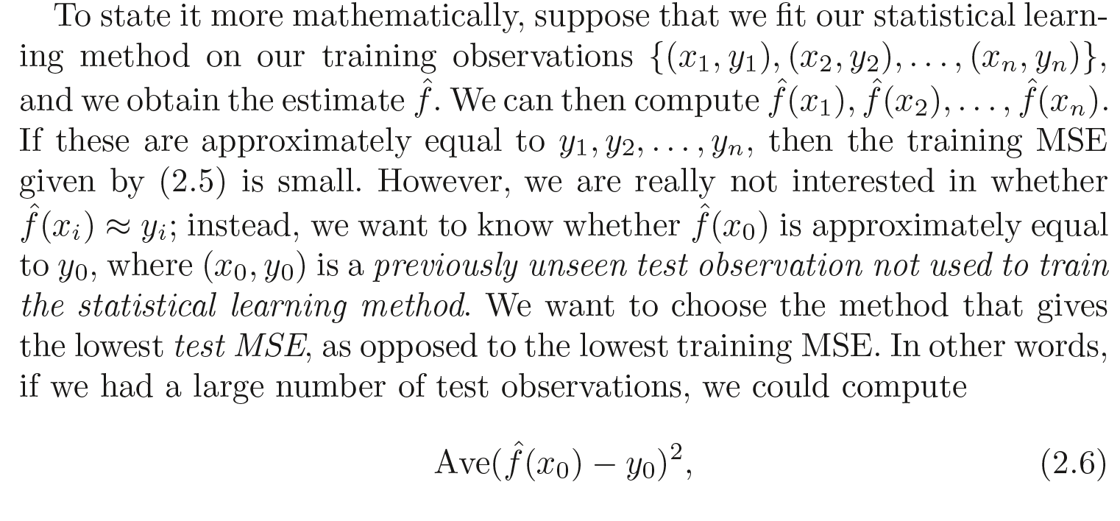
Average squared prediction error for these test observations

Slide 29
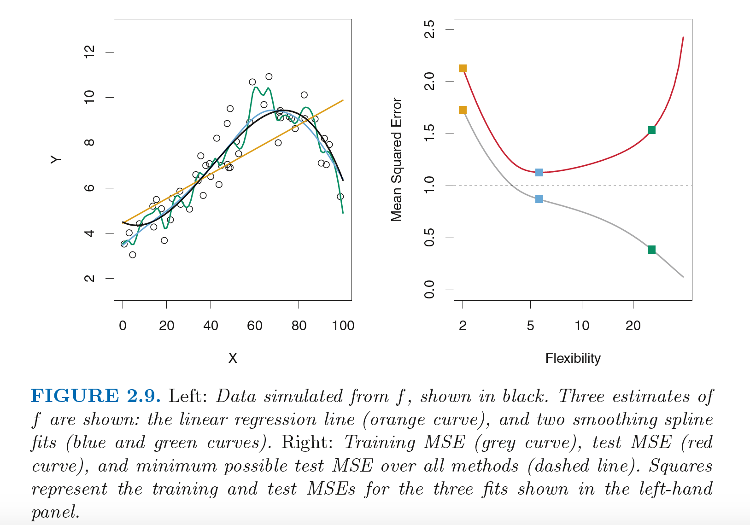

Slide 30
Previous slide inference points
The degrees of freedom is a quantity that summarizes the flexibility of a curve
As model flexibility increases, training MSE will decrease, but the test MSE may not. When a given method yields a small training MSE but a large test MSE, we are said to be overfitting the data.

Slide 31
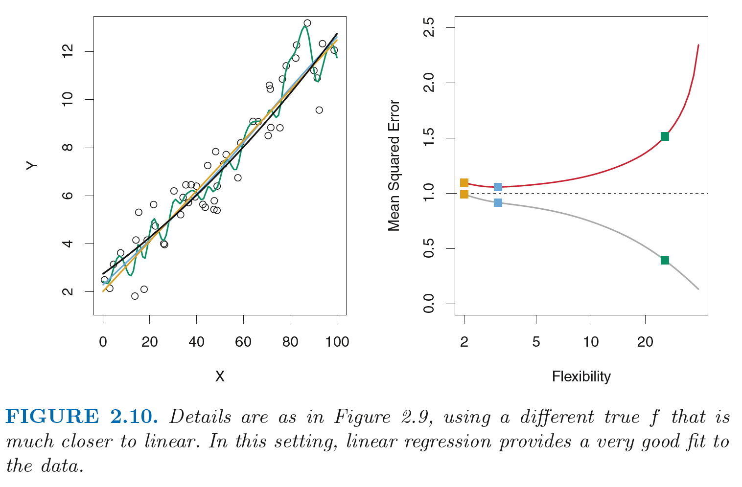

Slide 32
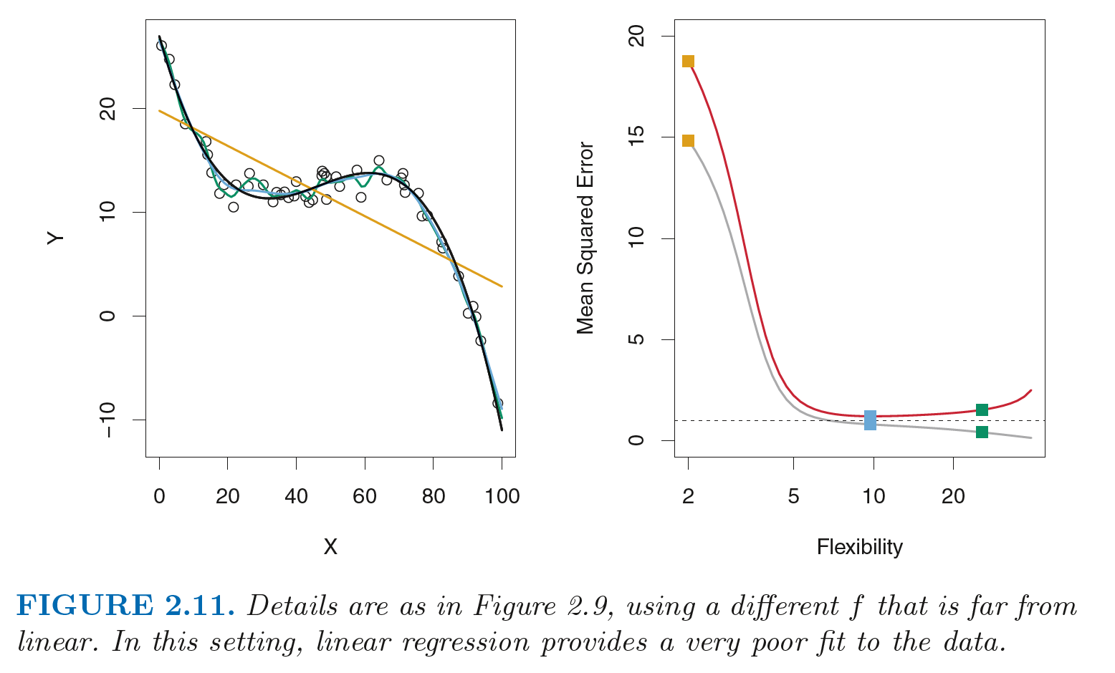

Slide 33
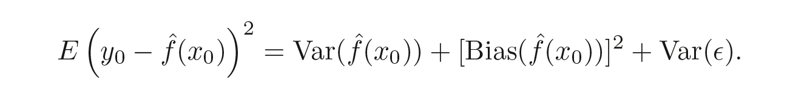
The Bias-Variance Trade-Off
The U-shape observed in the test MSE curves turns out to be the result of two competing properties of statistical learning methods.
Variance refers to the amount by which f estimation would change if we estimated it using a different training data set.
In general, more flexible statistical methods have higher variance
bias refers to the error that is introduced by approximating a real-life problem, which may be extremely complicated, by a much simpler model.

Slide 34
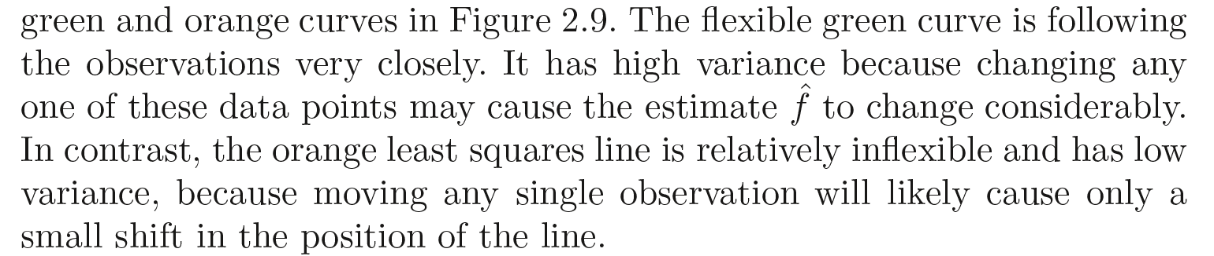

Slide 35
As a general rule, as we use more flexible methods, the variance will increase and the bias will decrease
The relative rate of change of these two quantities determines whether the test MSE increases or decreases

Slide 36
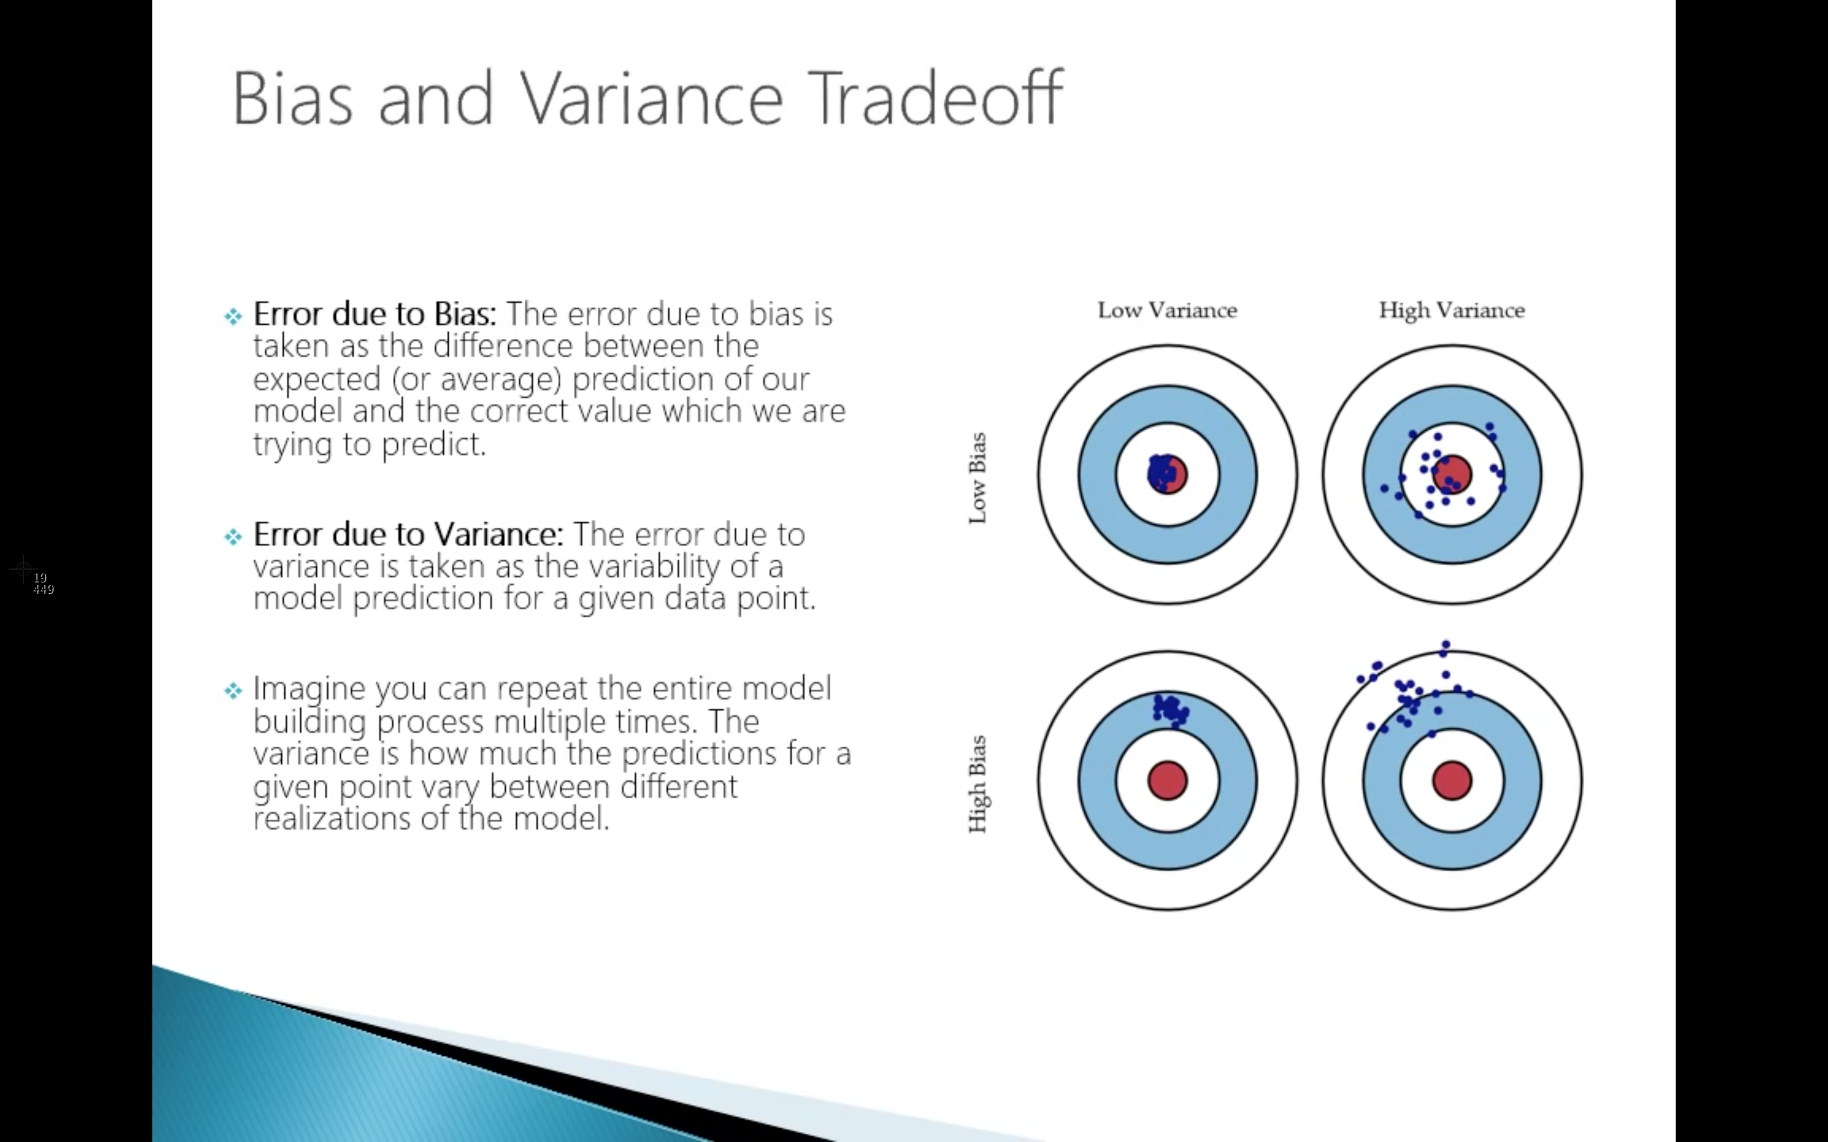

Slide 37
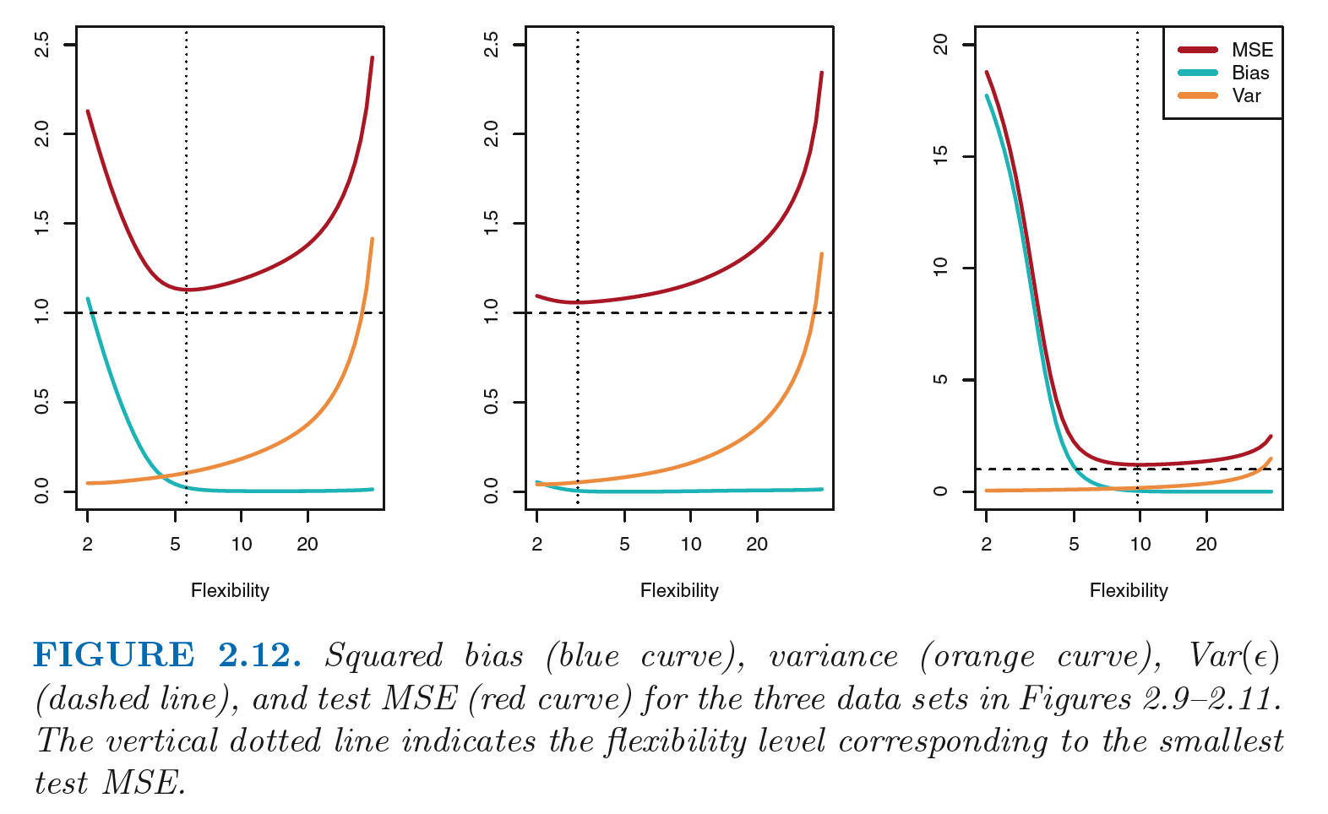

Slide 38
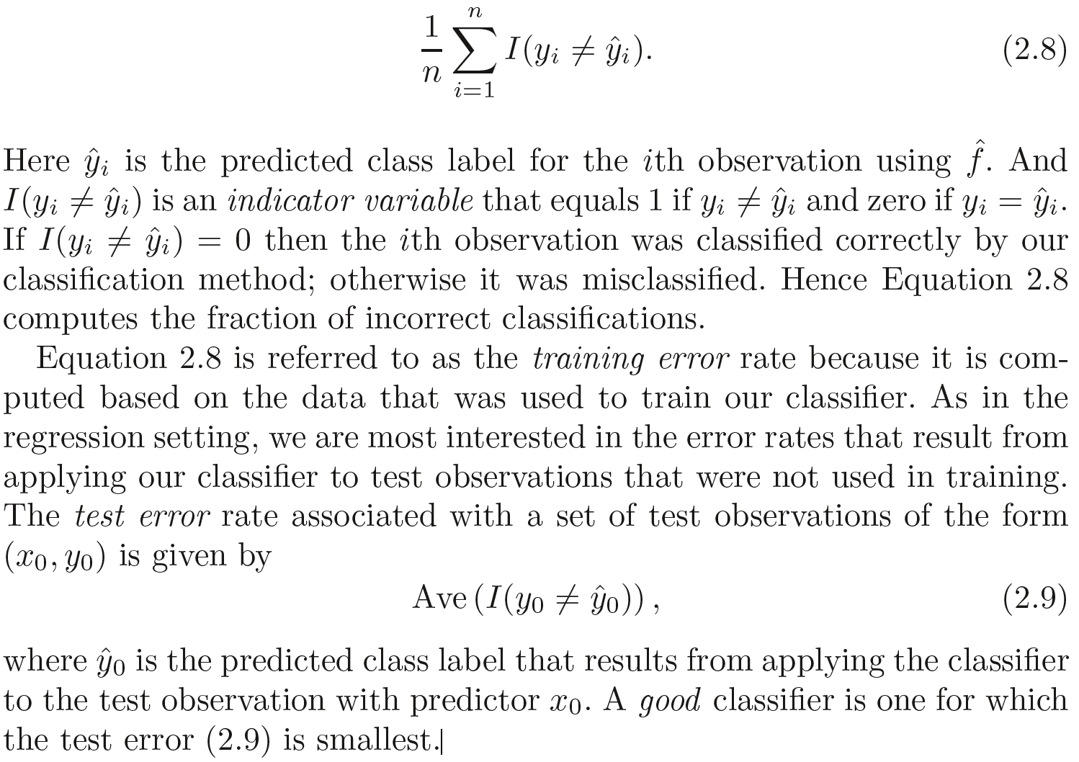
Model accuracy in Classification Setting
The most common approach for quantifying the accuracy of our estimate ˆ f is the training error rate , the proportion of mistakes that are made if we apply error rate our estimate ˆ f to the training observations:

Slide 39
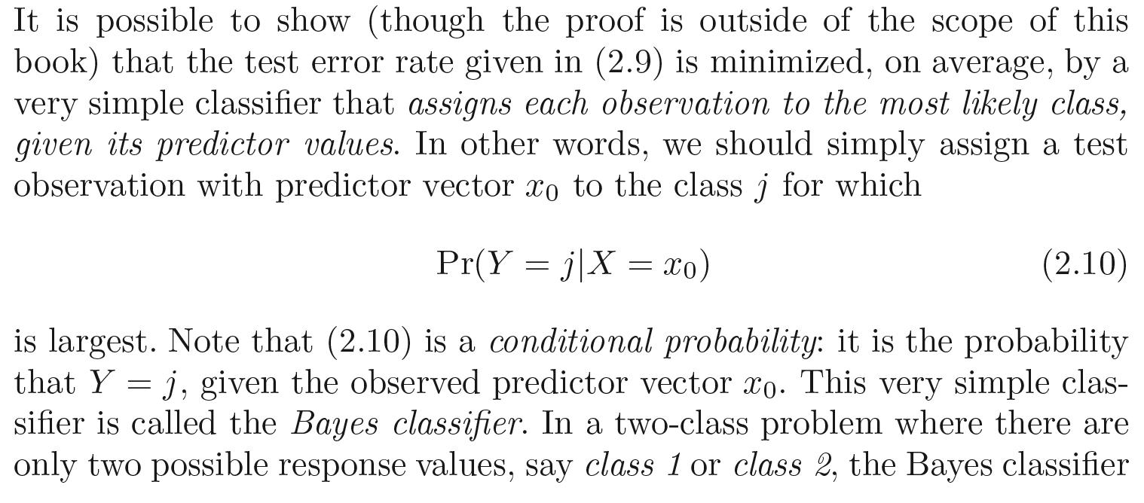
The Bayes Classifier

Slide 40
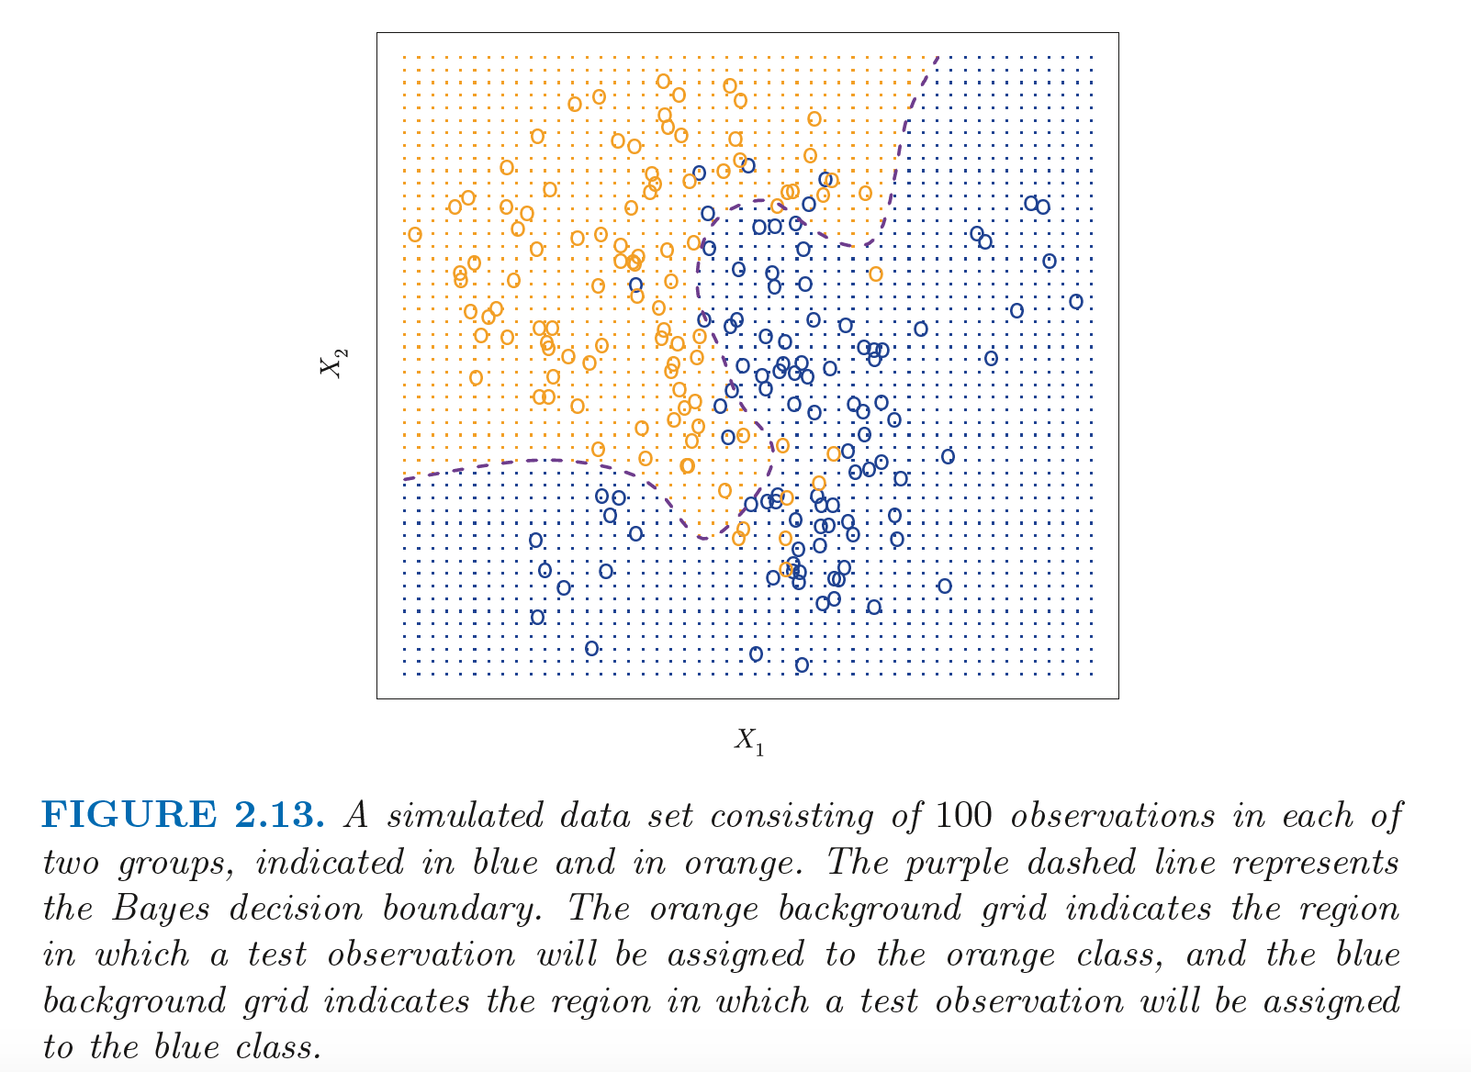

Slide 41
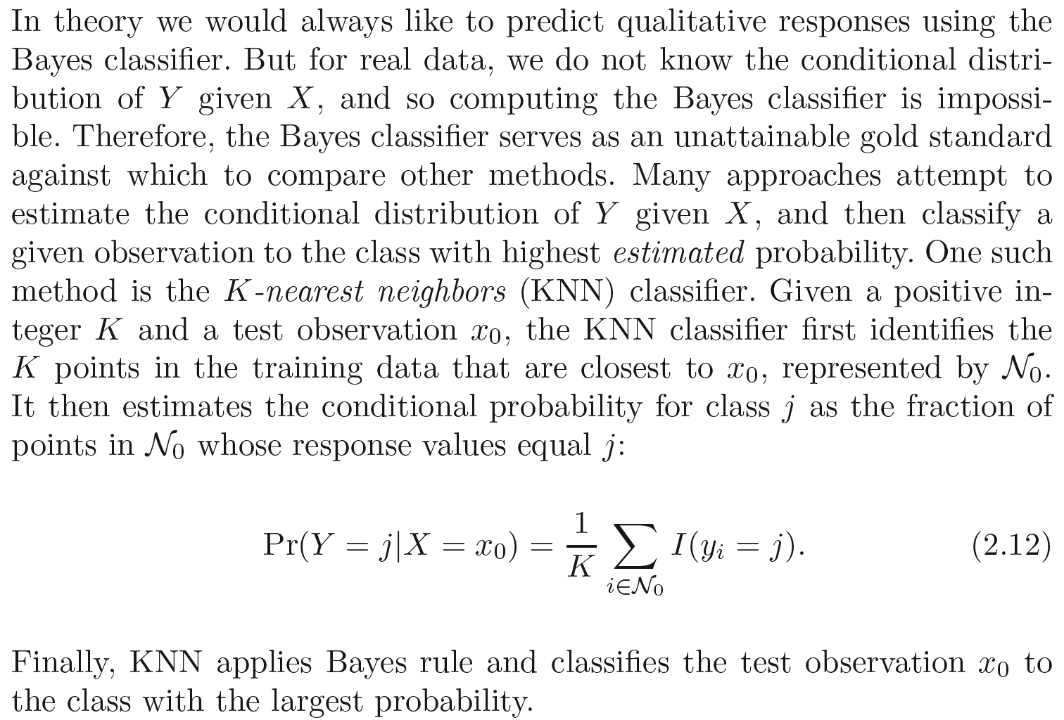
K-Nearest Neighbors

Slide 42
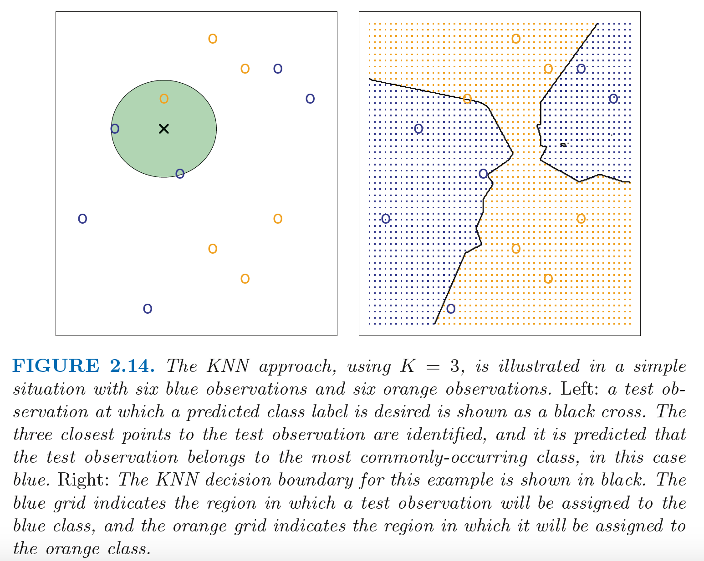

Slide 43
